Slide 1
SAP BTP Build Apps Training
Day 2
Anubhav Oberoy
www.AnubhavTrainings.com
Follow excellence with sheer passion

Slide 2


DISCLAIMER
The training content and delivery of this presentation is confidential, and cannot be recorded, or copied and distributed to any third party, without the written consent of Anubhav Trainings

Slide 3
Agenda
01
SAP Build
02
Fusion Team
03
Build workzone

Slide 4
A Quick History
Hybrid App
Fiori Apps can be converted to APK using cordova plugin with WebIDE tool
Medix
Mendix is a low-code platform that allows users to build applications, including those with SAP Fiori UI styling, without extensive coding
2013
2021
2022
SAP UI5
UI5 framework was introduced to design responsive web applications
AppGyver
AppGyver Oy, a pioneer in no-code development platforms that enable users with no coding skills to build applications for Web and mobile uses
SAP Build
Build Apps combining AppGyver, Medix and Build.me prototyping tool
2015
2021

Slide 5
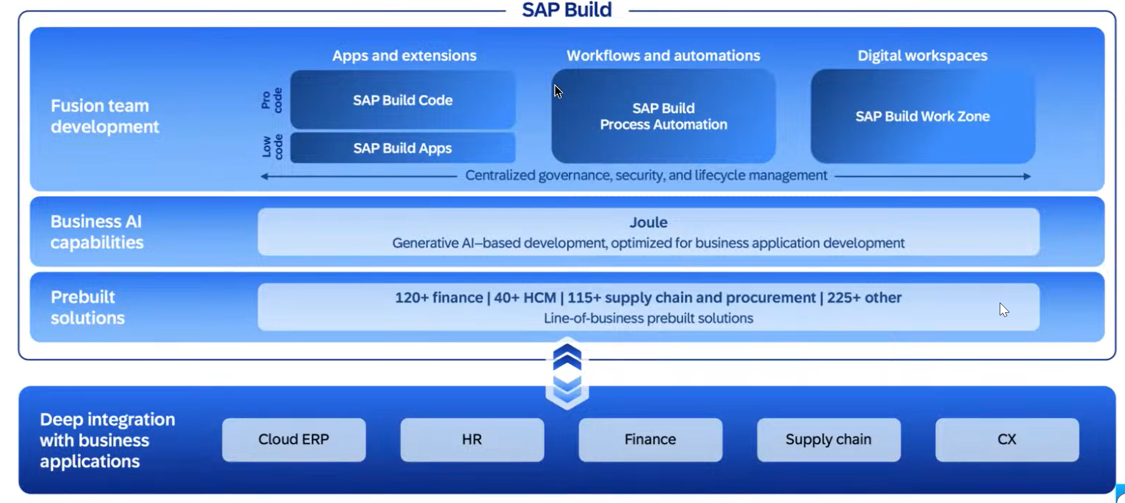
What is SAP Build

Slide 6
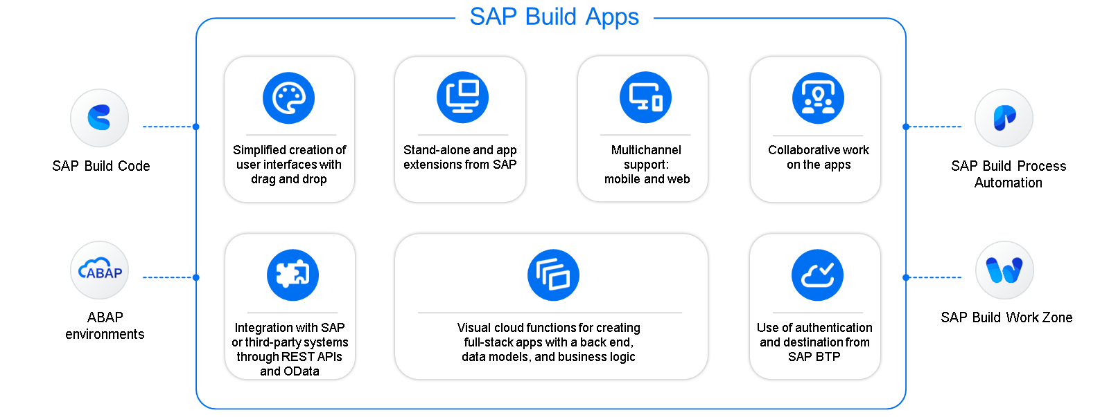
Key Capabilities

Slide 7
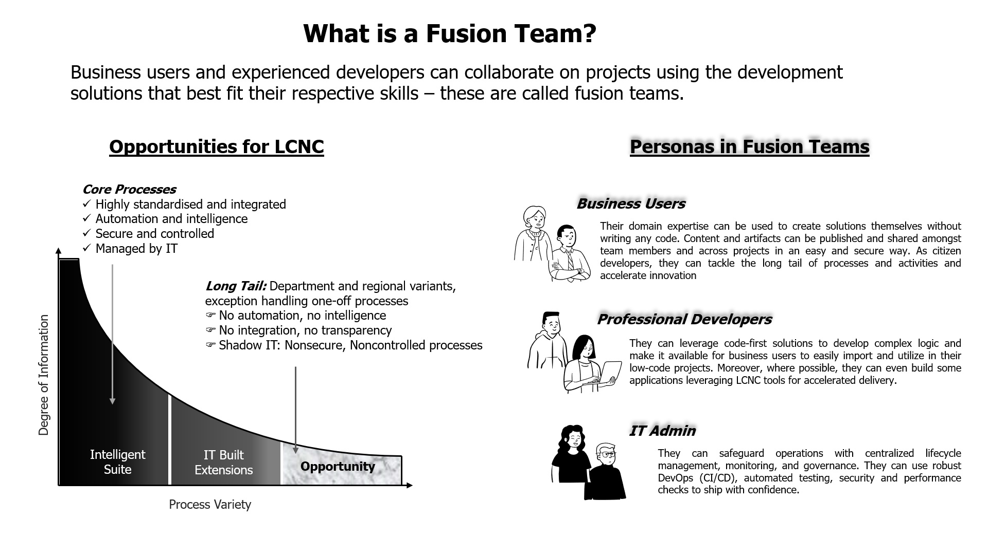
What is fusion Team?

Slide 8
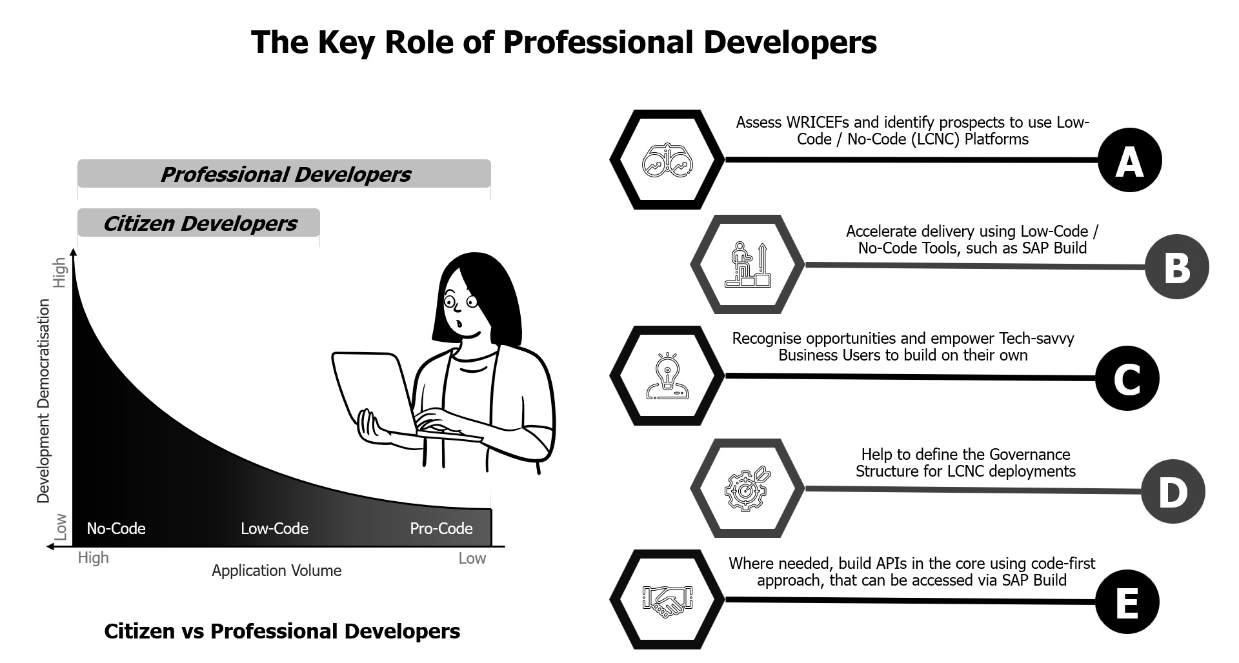
Key role of professional developers?

Slide 9
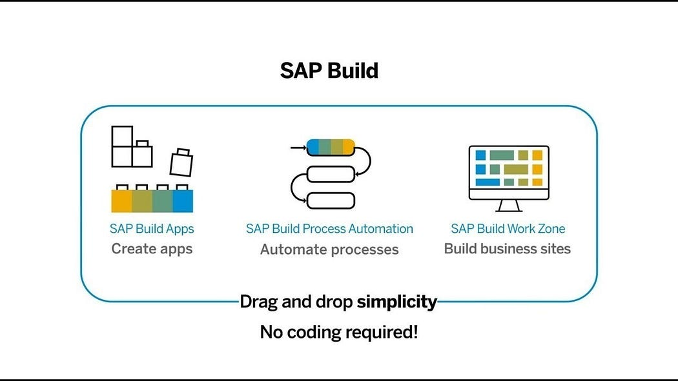
What is SAP Build?
SAP Build is a user-friendly low-code/no-code platform within the SAP Business Technology Platform (SAP BTP), designed to empower users to create, customize, and enhance applications, automate workflows, and build business sites without the need for advanced coding skills. It includes three primary components:

Slide 10
SAP Build Offerings?
SAP Build Process Automation
SAP Build WorkZone
SAP Build Apps
Purpose: Simplify the development of enterprise applications through an intuitive interface. Key Features:
Visual Development: Create UI, workflows, and logic using a drag-and-drop approach.
Prebuilt Templates: Leverage templates for common business scenarios.
Data Integration: Connect seamlessly with SAP and external systems through APIs.
Multi-Channel Deployment: Develop apps for both web and mobile platforms.
Collaboration Tools: Facilitate teamwork during the app-building process. Use Cases:
Developing HR onboarding solutions.
Building custom KPI tracking dashboards.
Creating customer-facing applications for feedback collection.
Purpose: Streamline business processes using workflows and robotic process automation (RPA). Key Features:
Workflow Automation: Manage approvals, notifications, and document routing automatically.
Prebuilt Bots: Access a library of bots to handle repetitive tasks like data entry.
Business Rules Management: Easily define and update business logic.
Process Visibility: Track and optimize workflows in real-time.
AI Integration: Utilize AI capabilities such as document recognition for enhanced automation. Use Cases:
Automating invoice approval workflows.
Managing employee leave requests.
Connecting and streamlining repetitive processes across systems.
Purpose: Design tailored business sites and portals for employees, customers, or partners. Key Features:
Prebuilt Templates: Quickly create branded portals.
Content Integration: Combine apps, dashboards, and workflows in a unified portal.
Role-Based Access: Customize content and permissions according to user roles.
Collaboration Features: Incorporate chat, forums, and knowledge-sharing tools.
Mobile-Friendly Design: Ensure accessibility across all devices. Use Cases:
Developing employee self-service platforms.
Creating customer support portals.
Building collaboration hubs for partners.

Slide 11
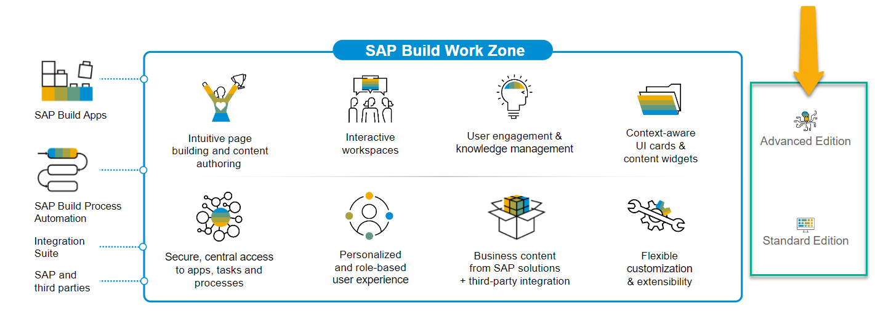
SAP Build Work Zone?
SAP Build Work Zone, advanced edition is a powerful SAP Business Technology Platform service that consists of several components
SAP Launchpad Services is now called SAP Build Work Zone, Standard SAP Work Zone is now called SAP Build Work Zone, Advanced

Slide 12
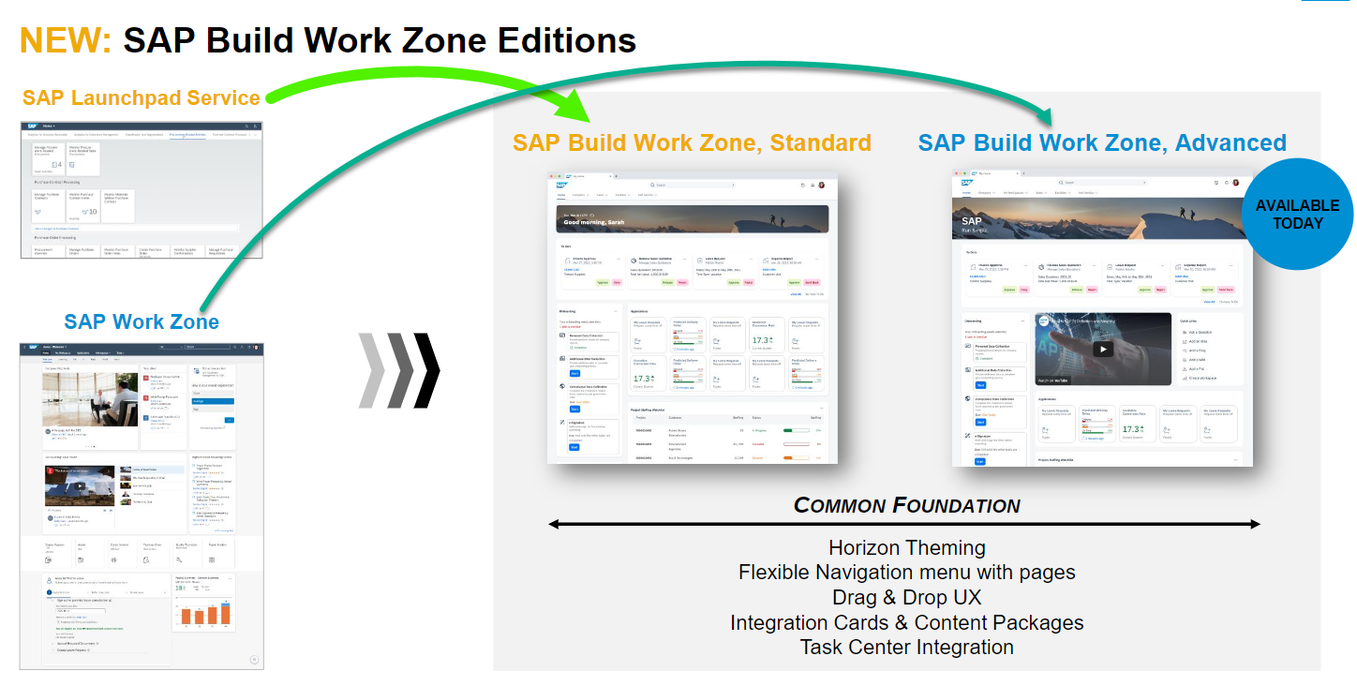
Offerings of Build Work Zone

Slide 13

Hands-on Setting up Build Work Zone

Slide 14
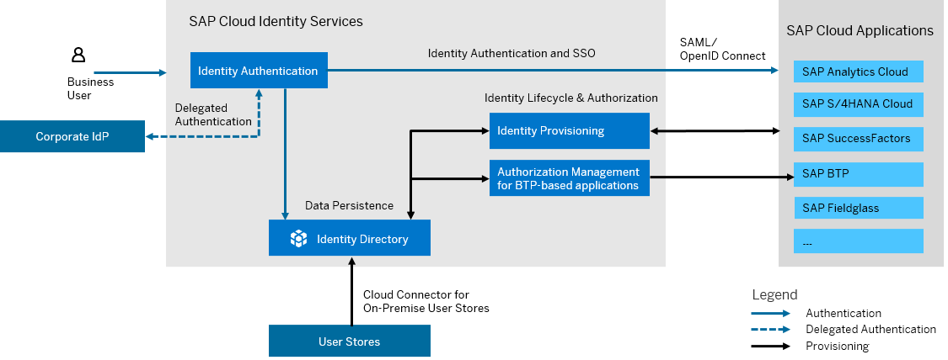
What is SAP Cloud Identity Service?
SAP Cloud Identity Services are a group of services of SAP Business Technology Platform (SAP BTP), which enable you to integrate identity and access management between systems. The goal is to provide a seamless single sign-on experience across systems while ensuring that system and data access are secure. SAP Cloud Identity Services include Identity Authentication, Identity Provisioning, Identity Directory and Authorization Management.

Slide 15
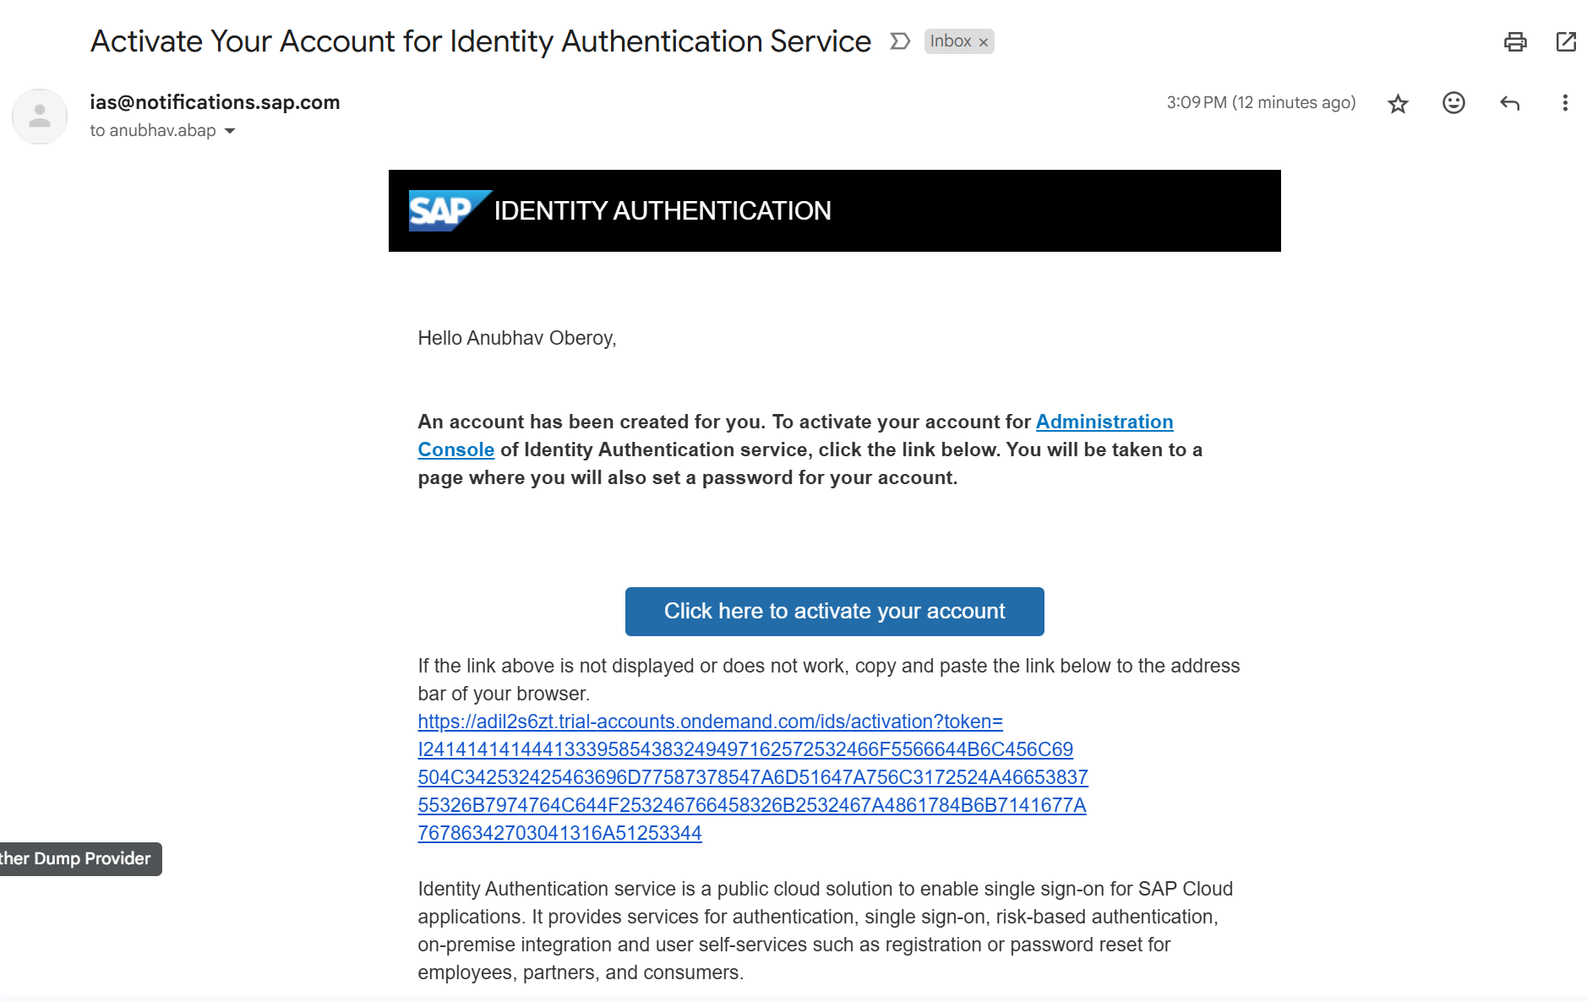
Become Admin for your Identity Service

Slide 16

What We Did
Let’s Summarize

Slide 17

www.anubhavtrainings.com
Thank You
End of Day 2

Slide 18


We’re committed to empower you to be
#FutureReady
through powerful training solutions.
We build the workforce of the future.
250+
Corporate Clients
30,000+
Learners Trained
25000+
Learners Placed
FREE WEBINARS
Sign up for free webinars with industry experts every fortnight!
Enroll Now!
Contact us today!
https://anubhavtrainings.com

